Slide 1
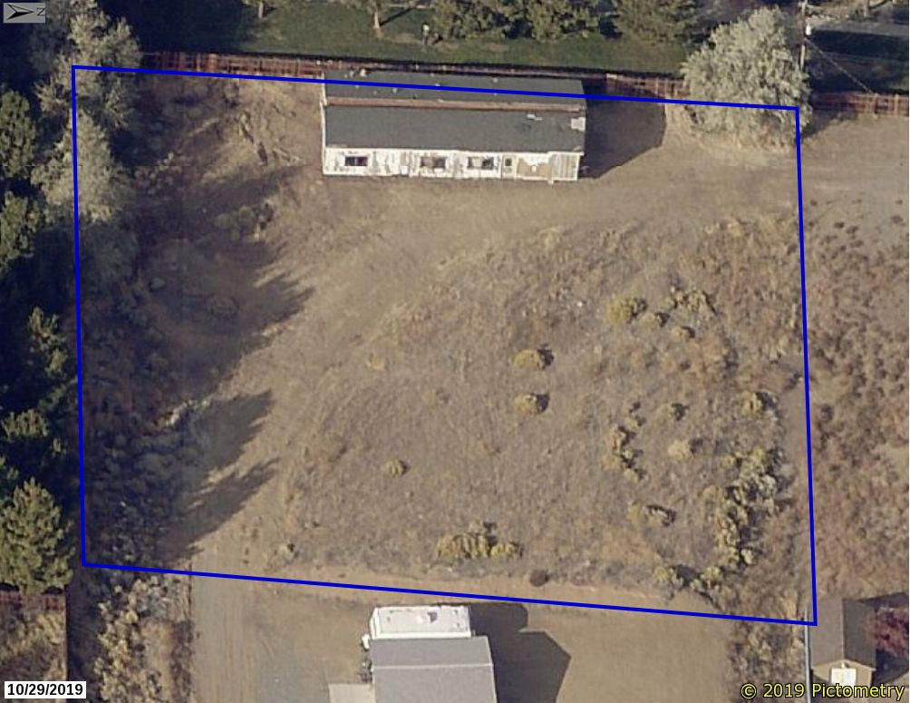
Washoe County Board of Adjustment
WVIO-PLA19-0176 (Anthony Appeal)
April 16, 2020

Slide 2
Background/Overview
Appeal of an Administrative Hearing Order
Per WCC Chapter 125, Administrative Enforcement Code – BOA is deciding body on such appeals…
If the matter involves a violation of WCC 110 (i.e. the Development Code)
BOA decision on the appeal is final unless a petition for judicial review is submitted
(which is then the final step in the process)

Slide 3
Background/Overview
Subject property is in the lower end of Sun Valley at 3765 Moorpark Ct.
.62-acre property surrounded by properties of similar size and configuration
Regulatory Zone is Medium Density Suburban (MDS)

Slide 4
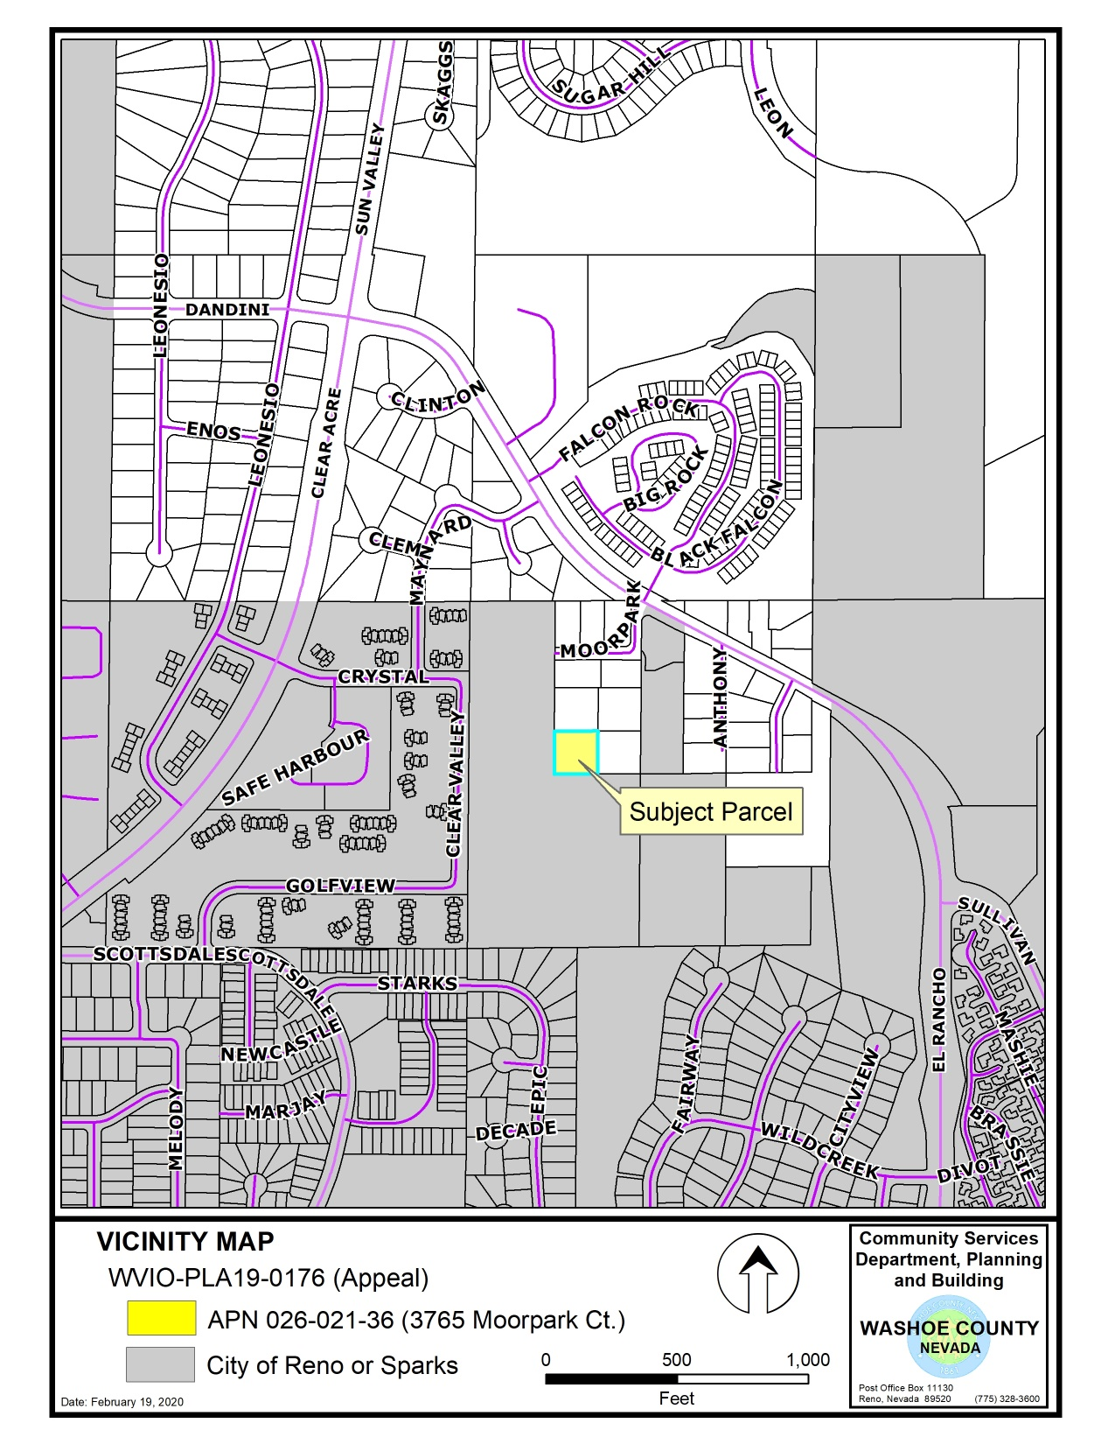

Slide 5
Background/Overview
Anonymous complaint received August 20, 2019
Alleged placement of a mobile home without the required set up permit.
Upon field investigation, the CEO confirmed that a mobile home was visibly stored on the property
Set up permit not issued according to county records
Constitutes storage of the home on vacant property (not allowed in MDS Regulatory Zone)

Slide 6
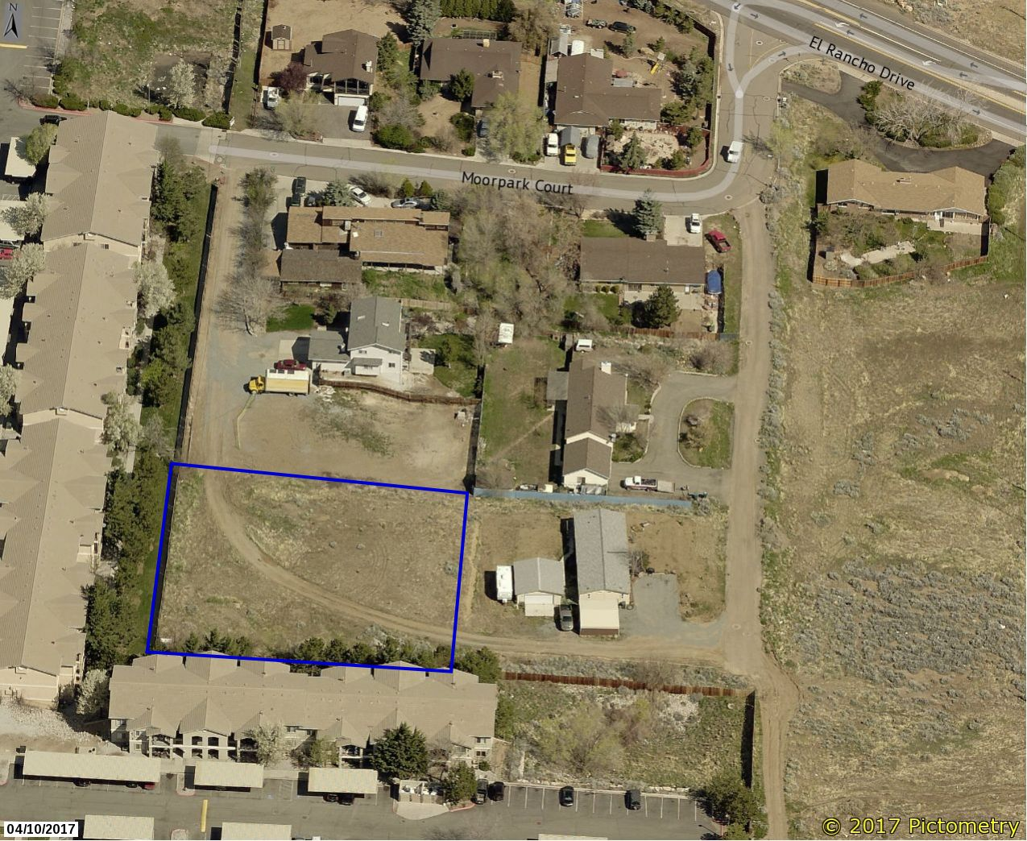
Background/Overview

Slide 7
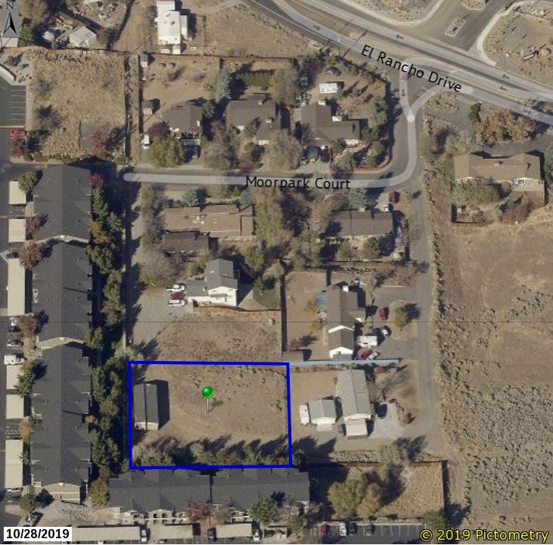
Background/Overview

Slide 8
Background/Overview
3765 Moorpark Ct

Slide 9
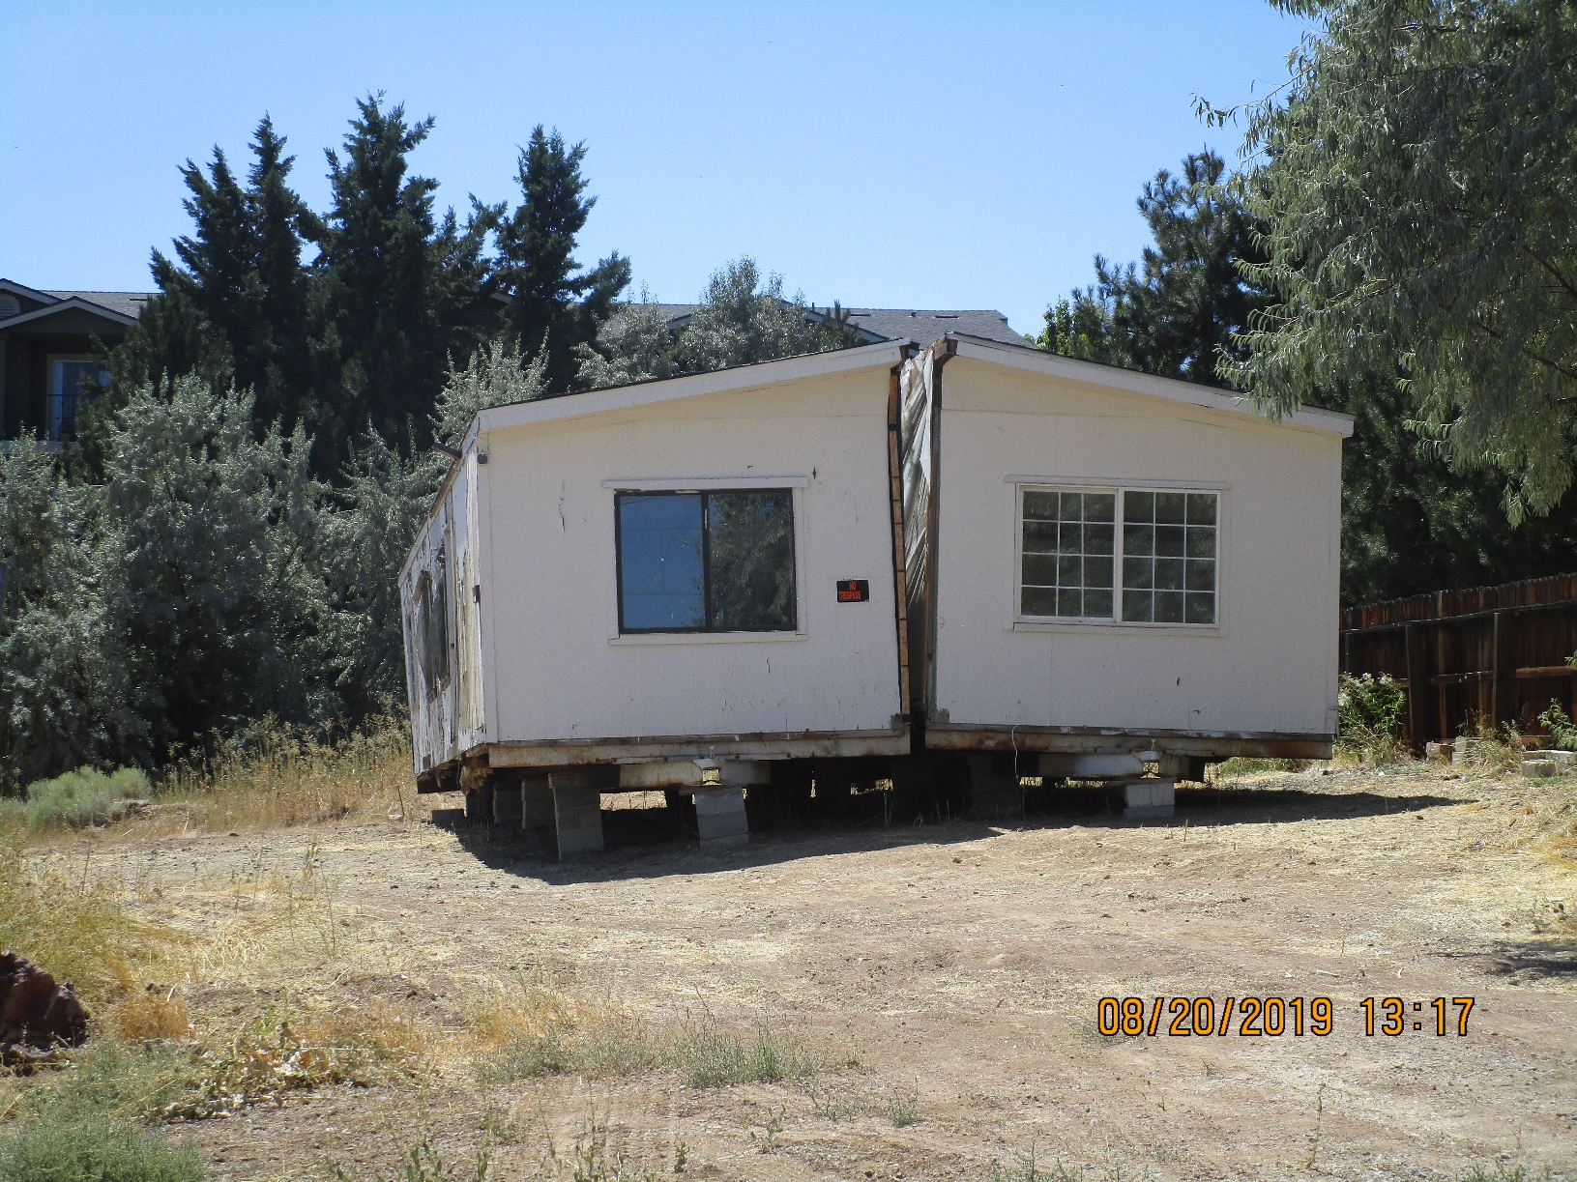
Background/Overview
3765 Moorpark Ct

Slide 10
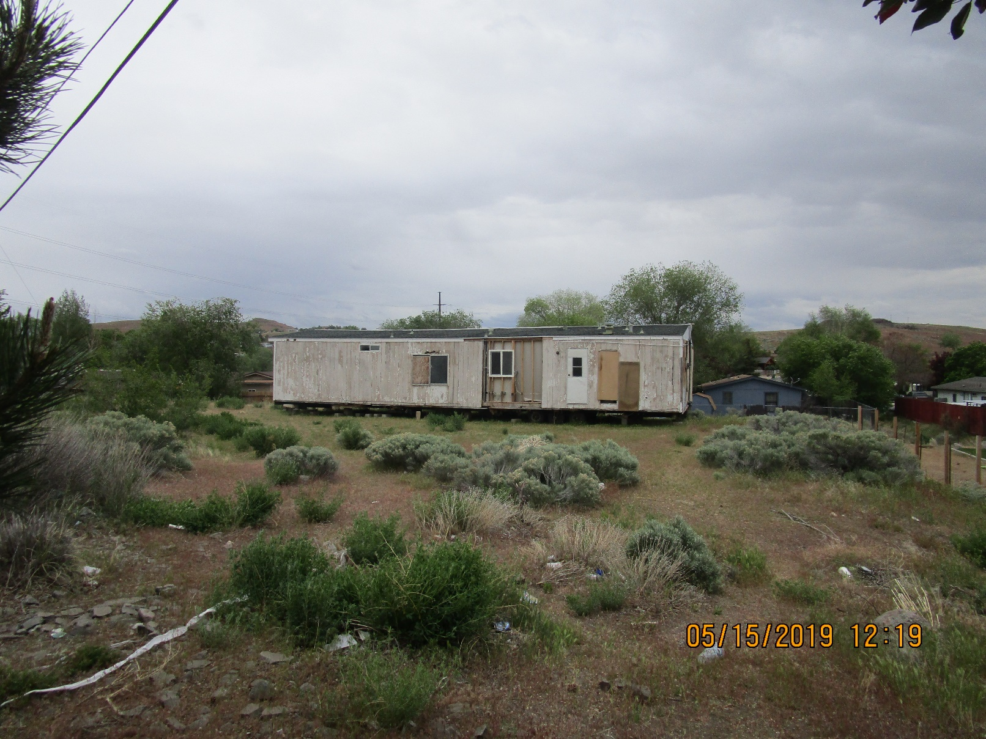
Background/Overview
4880 Sun Valley Blvd.

Slide 11
Background/Overview
Administrative Warning issued on August 22, 2019 compliance date of September 22, 2019 set
2nd Administrative Warning issued On September 24, new compliance date of October 27, 2019 granted
Due to non-compliance, 1st Penalty Notice issued on October 29, 2019
Owner appealed PN on November 30, 2019
Administrative Hearing held on January 15, 2020

Slide 12
Background/Overview
Administrative Hearing Officer confirmed the violation (based on evidence and testimony at hearing)
Administrative Order issued requiring:
  Legalize placement by obtaining a building permit; or,
  Remove home by no later than April 1, 2020
Owner appealed order on February 4, 2020 to the BOA
Proceedings stayed until disposition of BOA appeal hearing

Slide 13
Analysis
Violation of WCC 110.306.35(j), Mobile Home Set Up Permit Required. (outdoor storage prohibited)
As staff understands it, the appellant has argued that Washoe County ordinances do not apply to them
The appellant has recorded scores of fake or unauthenticated documents at the Recorders office to support their argument(s)
Claiming “Sovereign” status over property (similar to Native American sovereignty)

Slide 14
Analysis
Property is fee simple real property, has an APN, and is subject to taxation; any allodial title claims are false
Owners have been paying taxes since at least 2015; have not paid for 2019 to current date
Owner has stated they do not intend to obtain a mobile home set up permit;
Citing cost and complexity of permit process; lack of authority by county to require permit
Only other available remedy, then, is removal

Slide 15
Public Notice and CAB
Public notice is not required as part of an administrative enforcement action
Only noticing requirement is to notice the violator / appellant and provide due process
The appellant has been provided notice and due process as required by Chapter 125
CAB review and/or input is not part of an administrative enforcement action

Slide 16
Reviewing Agencies
No other agencies have been involved in this administrative enforcement action

Slide 17
Findings
The BOA is not required to make specific findings in reaching a decision on this appeal
Public record and body of evidence is sufficient
A written order of the BOA decision will be prepared and executed by the Chair; and,
A copy of the order is served on the appellant
If the appeal is denied, the BOA should include in the written order / decision a compliance plan (e.g. remove the vehicle by xx date)

Slide 18
Possible Motion
I move that, after giving reasoned consideration to the information contained in the staff report and information received during the public hearing, the Washoe County Board of Adjustment deny this appeal and affirm the decision of the Administrative Hearing Officer that the appellant is in violation of Washoe County Code Section 110.306.35(j), and uphold the hearing officers’ order to either remove the subject manufactured home or obtain a set up permit by <insert date>, 2020; and, authorize the Chair of the Board of Adjustment to prepare a written order of the decision and file it with the Secretary of the Board of Adjustment, a copy of which shall be served to the appellant.

Slide 19
Appeal Process
The appellant has the right to appeal the written order by filing a petition for judicial review in the Second Judicial District Court for the State of Nevada within 25 days from the date the order is mailed to the appellant. Per WCC Section 110.910.15(i)(6), when a petition for judicial review is filed, the court rules shall govern the proceeding and the requested judicial review is in lieu of an appeal to the Board of County Commissioners as authorized by NRS 278.310(3)(b).

